Slide 1
Shufersal
item substitute system for On-line sales

Slide 2

Agenda
Business Issue
Target value
EDA
Data Preparation & Data Manipulation
Models & Scores
Last stage
Conclusion
Future options

Slide 3
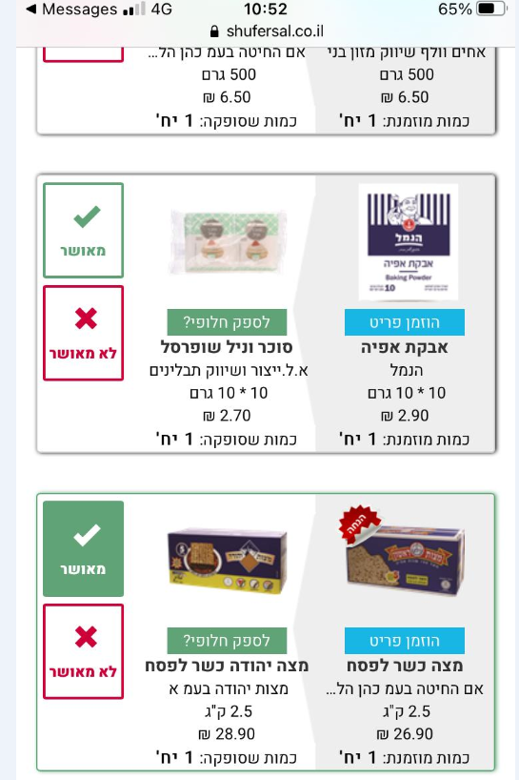
Business Issue
The online sales in Shufersal is 22% of sales in 2021, and growth every month
Our data is based on the SMS system of substitute products, and show if customer approved or denied the proposal substitute
Not having subs prod or having bad subs prod, cut sales!
Only one chance to win!

Slide 4
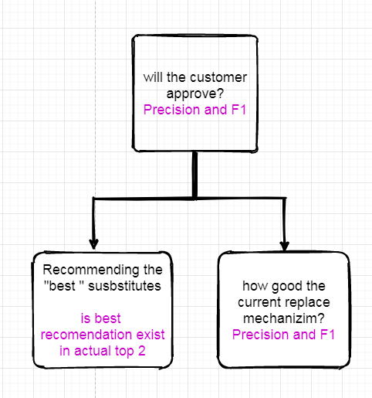
Target value and model process

Slide 5
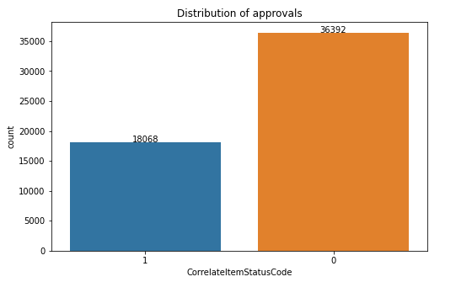
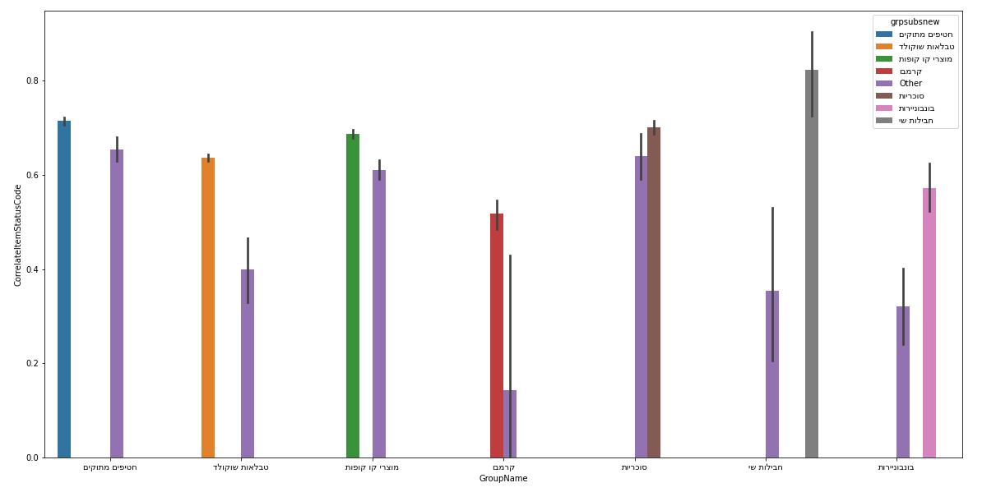
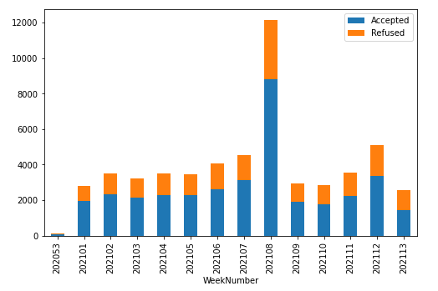
EDA
Data distribution
Distribution over time
Substitute groups

Slide 6
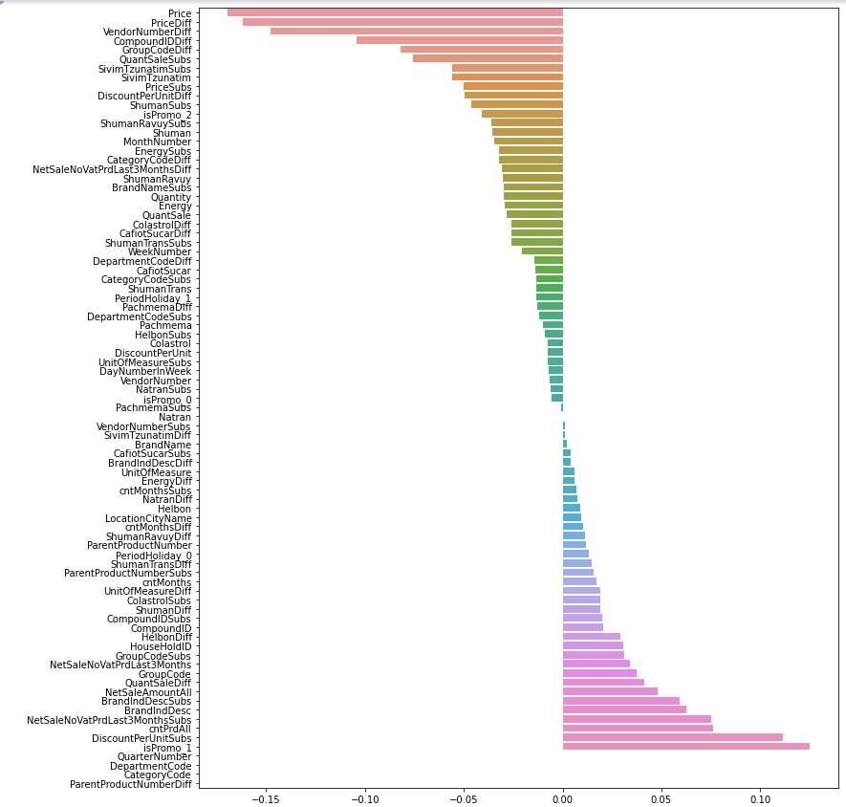

Slide 7

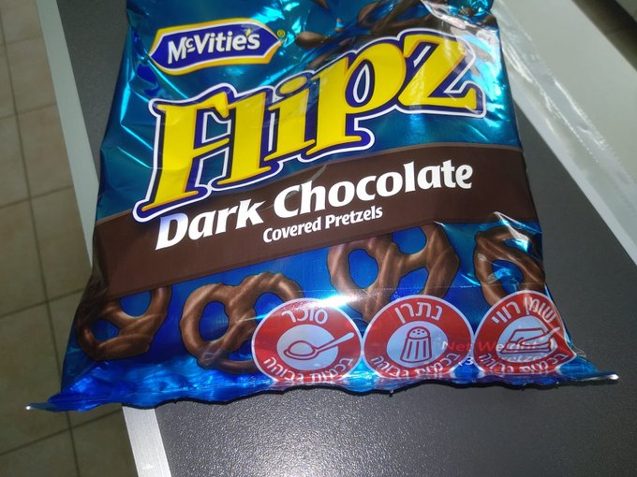
Data Preparation & Data Manipulation
The main dataset contains the sweets category
Diff varying types:
absolute diff
Ratio diff
Relative diff
Without Diff
Dummies
Product statistics panel by sales
Date to period - holiday indication
important info - Promoted products, ingredients

Slide 8

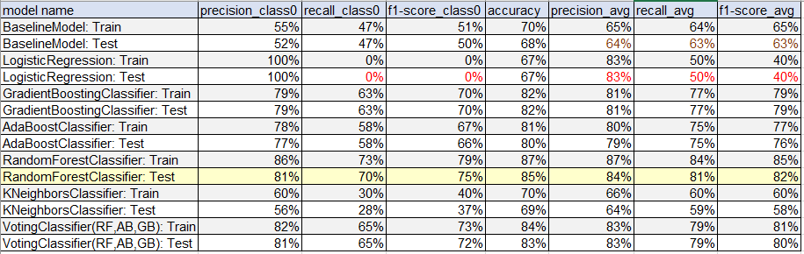
Models & Scores
Random Forest has the best score of precision and F1

Slide 9
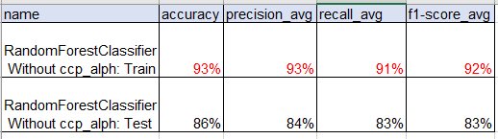
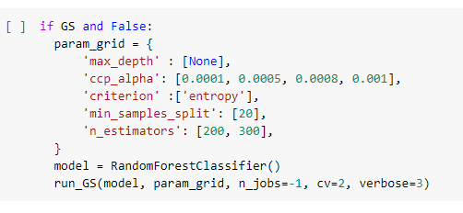
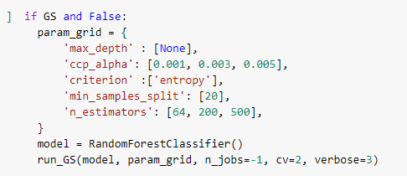
Models & Scores
In order to eliminate the overfitting, we used Hyperparameter ccp_alpha in Grid-Search for pruning the trees
In grid search we got the smallest option in ccp_alpha therefore we run it again with more options smaller then previous

Slide 10
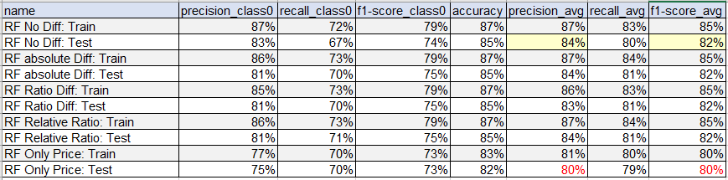
Models & Scores
The Diff options didn’t change the results of the model
we get the same results also without the Diff features, just the feature importance changed

Slide 11
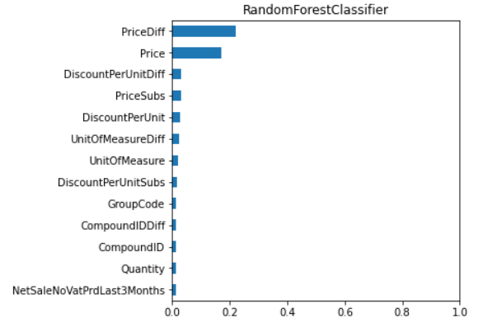
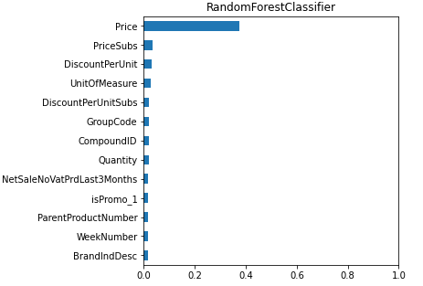
Models & Scores
Feature Importance of absolute Diff and without Diff features
FE with absolute Diff
FE without Diff

Slide 12
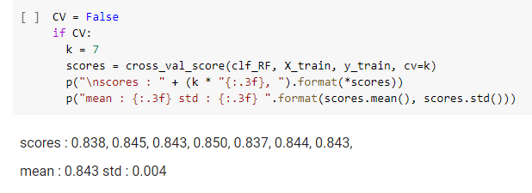
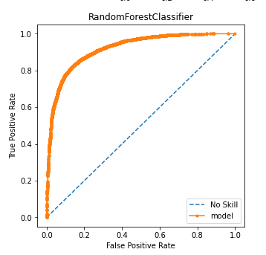
Models & Scores
The model is robust by the cross validation
The AUC is 0.919 and by the graph can see that we get 80% TF with 20% FP

Slide 13
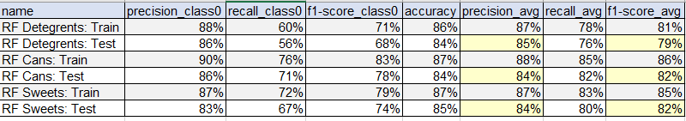
Last stage
Use additional datasets to validate the model Cans & Detregents

Slide 14
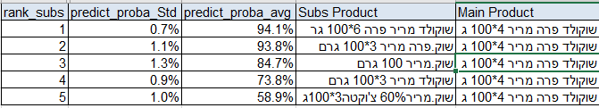
Last stage
Recommendation system
Get the predict_proba of RF model
Calculate avg and Std of soft predict for every product and subs
Rank every couple of product by 80% avg and 20% Std
Test if best subs by model exist in top 2 subs on actual data and found it in 89%

Slide 15
Conclusion
Model is robust and valid
The same model tried over different data
Random forest has the best accuracy
In baseline model we get 64% precision and 63% F1 while in RF the metrics was 84% precision and 82%
New recommendation based on predict probe

Slide 16
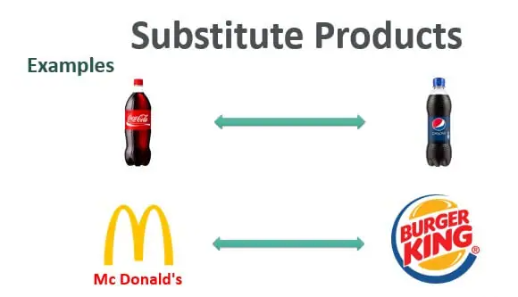
Future development
Run Model per Category over all products tree
Clustering
Personalization!

